Slide 1
CSE 219
Computer Science III
Object Oriented Design
using UML

Slide 2
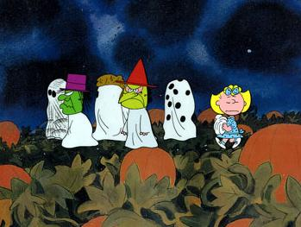
Think back to Halloween

Slide 3
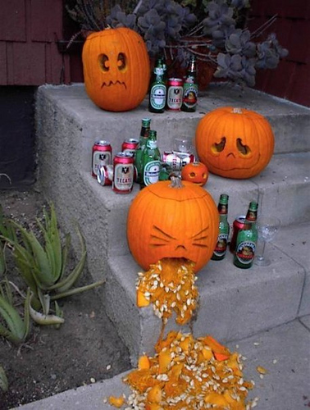
Time to Make a Jack O'Lantern

Slide 4
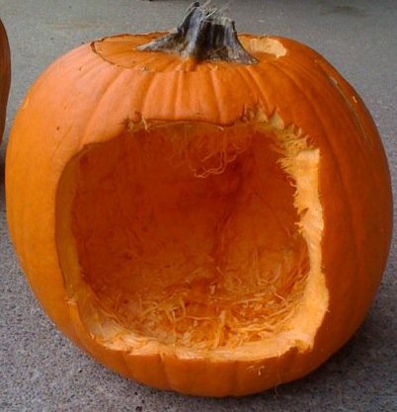
Without a plan, your Jack is doomed

Slide 5
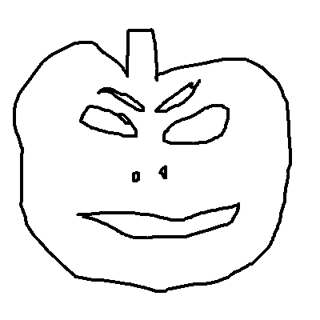


Design, prototype, then implement

Slide 6
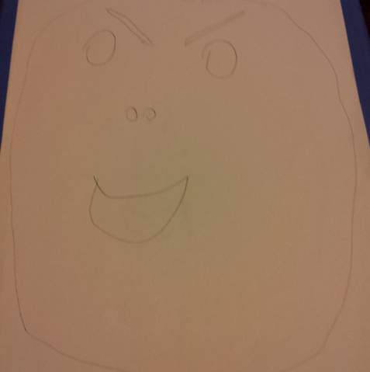
Design

Slide 7
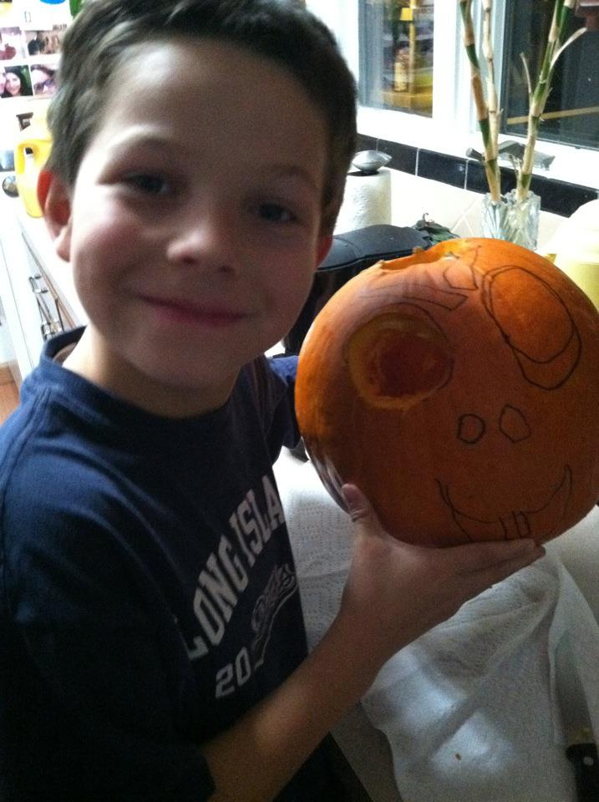
Prototype

Slide 8
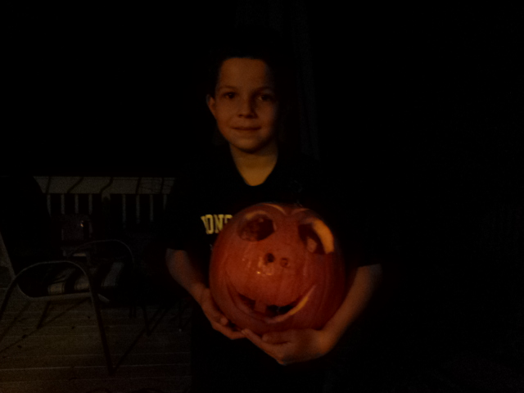
Implement

Slide 9

Enjoy

Slide 10

And of course smash

Slide 11
How can these properties be achieved?
By using well proven, established processes
  preferably while taking advantage of good tools
Software Development Life Cycle
Requirements Analysis
Design & Document
Evaluate Design
Code
Test
Deploy
Profile
Debug

Slide 12
Design Approaches
Have other “similar” problems been solved?
  Do design patterns exist to help?
What are the “easy” and “hard” parts?
  Why is this important?
    work measurement
Employ:
  data-driven design
  top-down design

Slide 13
Data-driven Design
From the problem specification, extract
  nouns (objects, attributes of objects)
  verbs (methods)
Divide data into separate logical, manageable groupings
  these will form your objects
Note needs for data structures or algorithms
  design your data management classes early on

Slide 14
Class relationships
Think data flow:
  What HAS what?
  What IS what?
  What USES what?
  Where should data go?
  How will event handler X change data in class Y?
  Static or non-static?
Design patterns will help us make these decisions
Bottom line: think modular
  no 1000 line classes or 100 line methods

Slide 15
Modularity
How reusable are your classes?
  can they be used in a future project?
Think of programmers, not just users
Can individual classes be easily separated and re-used
Data vs. Mechanics
Functionality vs. Presentation

Slide 16
Functionality vs. Presentation
What is a game state manager (GSM)?
  classes that do the work of managing data & enforcing rules on that data
Why separate the GSM and the UI?
  so we can change the GSM without changing the UI
  so we can change the UI without changing the GSM
  so we can design several different UIs for an GSM
  reuse code that is proven to work
This is a common principle throughout GUI design
  even for Web sites (separate content)
  different programmers for each task

Slide 17
Choosing Data Structures
Internal data structures
  What is the natural representation of the given data?
  Setup vs. access speeds
  Keep data ordered?
    Which access algorithms?
    Ordered by what?

Slide 18
UML Diagrams
UML - Unified Modeling Language
UML diagrams are used to design object-oriented software systems
  represent systems visually
  provides a system architecture
  makes coding more efficient and system more reliable
  diagrams show relationships among classes and objects
Can software engineering be automated?
  Visual programming
  Patterns & frameworks
  CASE tools

Slide 19
Types of UML Diagrams
Types we'll make:
  Use Case Diagram
  Class Diagram
  Sequence Diagram
Others:
  State, Activity, Collaboration, Communication, Component, & Deployment Diagrams

Slide 20
UML Class Diagrams
A UML class diagram consists of one or more classes, each with sections for:
  class name
  instance variables
  methods
Lines between classes represent associations
  Uses
  Aggregation (HAS-A), also known as containment
  Inheritance (IS-A)

Slide 21
UML Class Responsibilities Diagrams
Class Name
Die
State Info: number of faces
value facing up
State info to be translated into instance variables
Responsibilities:
access instance variables
roll die
PairOfDice
State Info: die1: Die
die2: Die
Responsibilities:
access instance variables
roll dice
calculate total
Responsibilities to be translated into methods

Slide 22
UML Class Diagrams
Derived from class responsibilities diagrams
Show relationships between classes
  Class associations denoted by lines connecting classes
  A feathered arrow denotes a one-directional association
Connecting line means ClassA and ClassB have a relationship
ClassA
ClassB
Instance variable info
Instance variable info
Method header info
Method header info
Feathered arrow means ClassA knows of and uses ClassC, but ClassC has no knowledge of ClassA
ClassC
Instance variable info
Method header info

Slide 23
Method and Instance Variable Descriptions
Instance Variables Format
  variableName : variableType
  For example,
  upValue : int
Method Header Format
  methodName(argumentName :
  argumentType): returnType
  For example,
  setDie1(newDie1 : Die) : void
  $ denotes a static method or variable, for example:
  $ myStaticMethod(x : int) : void

Slide 24
UML Class Diagrams & Aggregation
UML class diagram for PairOfDice & Die:
Diamond denotes aggregation
PairOfDice HAS-A Die
PairOfDice
Die
die1: Die
die2: Die
numFaces: int
upValue : int
1
2
getDie1() : Die
getDie2() : Die
getTotal() : int
rollDice() : void
setDie1(newDie1: Die) : void
setDie2(newDie2: Die) : void
getUpValue() : int
getNumFaces() : int
roll() : void
Denote multiplicity, 2 Die object for each PairOfDice object

Slide 25
UML Class Diagrams & Inheritance
public class Student extends Person
Person
name: String
age : int
getAge() : int
getName() : String
setAge(newAge: int) : void
Triangle denotes inheritance
Student IS-A Person
Student
gpa: double
getGPA() : double
setGPA(newGPA: double) : void

Slide 26
Encapsulation
We can take one of two views of an object:
  internal - the variables the object holds and the methods that make the object useful
  external - the services that an object provides and how the object interacts
From the external view, an object is an encapsulated entity, providing a set of specific services
These services define the interface to the object
  abstraction hides details from the rest of the system

Slide 27
Class Diagrams and Encapsulation
In a UML class diagram
  public members can be preceded by +
  private members are preceded by -
  protected members are preceded by #
PairOfDice
Die
die1: Die
die2: Die
- numFaces: int
- upValue : int
+ getDie1() : Die
+ getDie2() : Die
+ getTotal() : int
+ rollDice() : void
+ setDie1(newDie1: Die) : void
+ setDie2(newDie2: Die) : void
+ getUpValue() : int
+ getNumFaces() : int
+ roll() : void

Slide 28
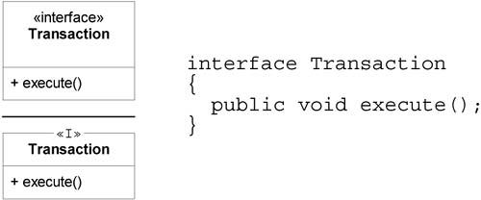
Interfaces in UML
(http://www.informit.com/articles/article.asp?p=336264&seqNum=3)
2 ways to denote an interface
  <<interface>>, OR
  <<I>>

Slide 29
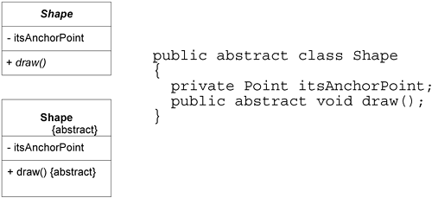
Abstract Classes in UML
(http://www.informit.com/articles/article.asp?p=336264&seqNum=3)
2 ways to denote a class or method is abstract:
  class or method name in italics, OR
  {abstract} notation

Slide 30
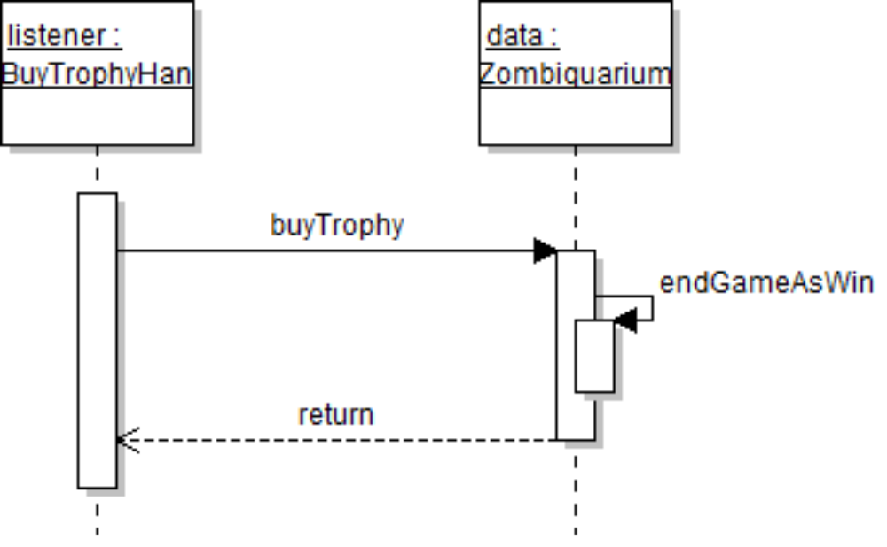
UML Sequence Diagrams
Demonstrate the behavior of objects in program
  describe the objects and the messages they pass
  diagrams are read left to right and descending

Slide 31
What will we use UML Diagrams for?
Use Case Diagrams
  describe all the ways users will interact with the program
Class Diagrams
  describe all of our classes for our app
Sequence Diagrams
  describe all event handling

Slide 32
Top-down class design
Top-down class design strategy:
  Decompose the problem into sub-problems (large chunks)
    software decomposition
  Write skeletal classes for sub-problems.
  Write skeletal methods for sub-problems.
  Repeat for each sub-problem.
If necessary, go back and redesign higher-level classes to improve:
  modularity
  information hiding
  information flow
  etc.

Slide 33
Designing Methods
Decide method signatures
  numbers and types of parameters and return values
Write down what a method should do
  use top-down design
    decompose methods into helper methods
Use javadoc comments to describe methods
Use method specs for implementation

Slide 34
Results of Top-down class design
UML Class Diagrams
Skeletal Classes
instance variables
static variables
class diagrams
method headers
DOCUMENTATION

Slide 35
Software Longevity
The FORTRAN & COBOL programming languages are almost 50 years old
  many mainframes still use code written in the 1960s
  software maintenance is more than ½ a project
Moral of the story:
  the code you write may outlive you, so make it:
    Easy to understand
    Easy to modify & maintain
  software must be ready to accommodate change

Slide 36
Software Maintenance
What is software maintenance?
Improving or extending existing software
  incorporate new functionality
  incorporate new data to be managed
  incorporate new technologies
  incorporate new algorithms
  incorporate use with new tools
  incorporate things we cannot think of now

Slide 37
Summary
Always use data driven & top-down design:
  identify and group system data
  identify classes, their methods and method signatures
  determine what methods should do
  identify helper methods
    Write down step by step algorithms inside methods to help you!!!
  document each class, method and field
  specify all conditions that need to be enforced or checked
    decide where to generate exceptions
    add to documentation
  evaluate design, and repeat above process
    until implementation instructions are well-defined

Slide 38
pathX

